Slide 1
Terminal Application

Slide 2
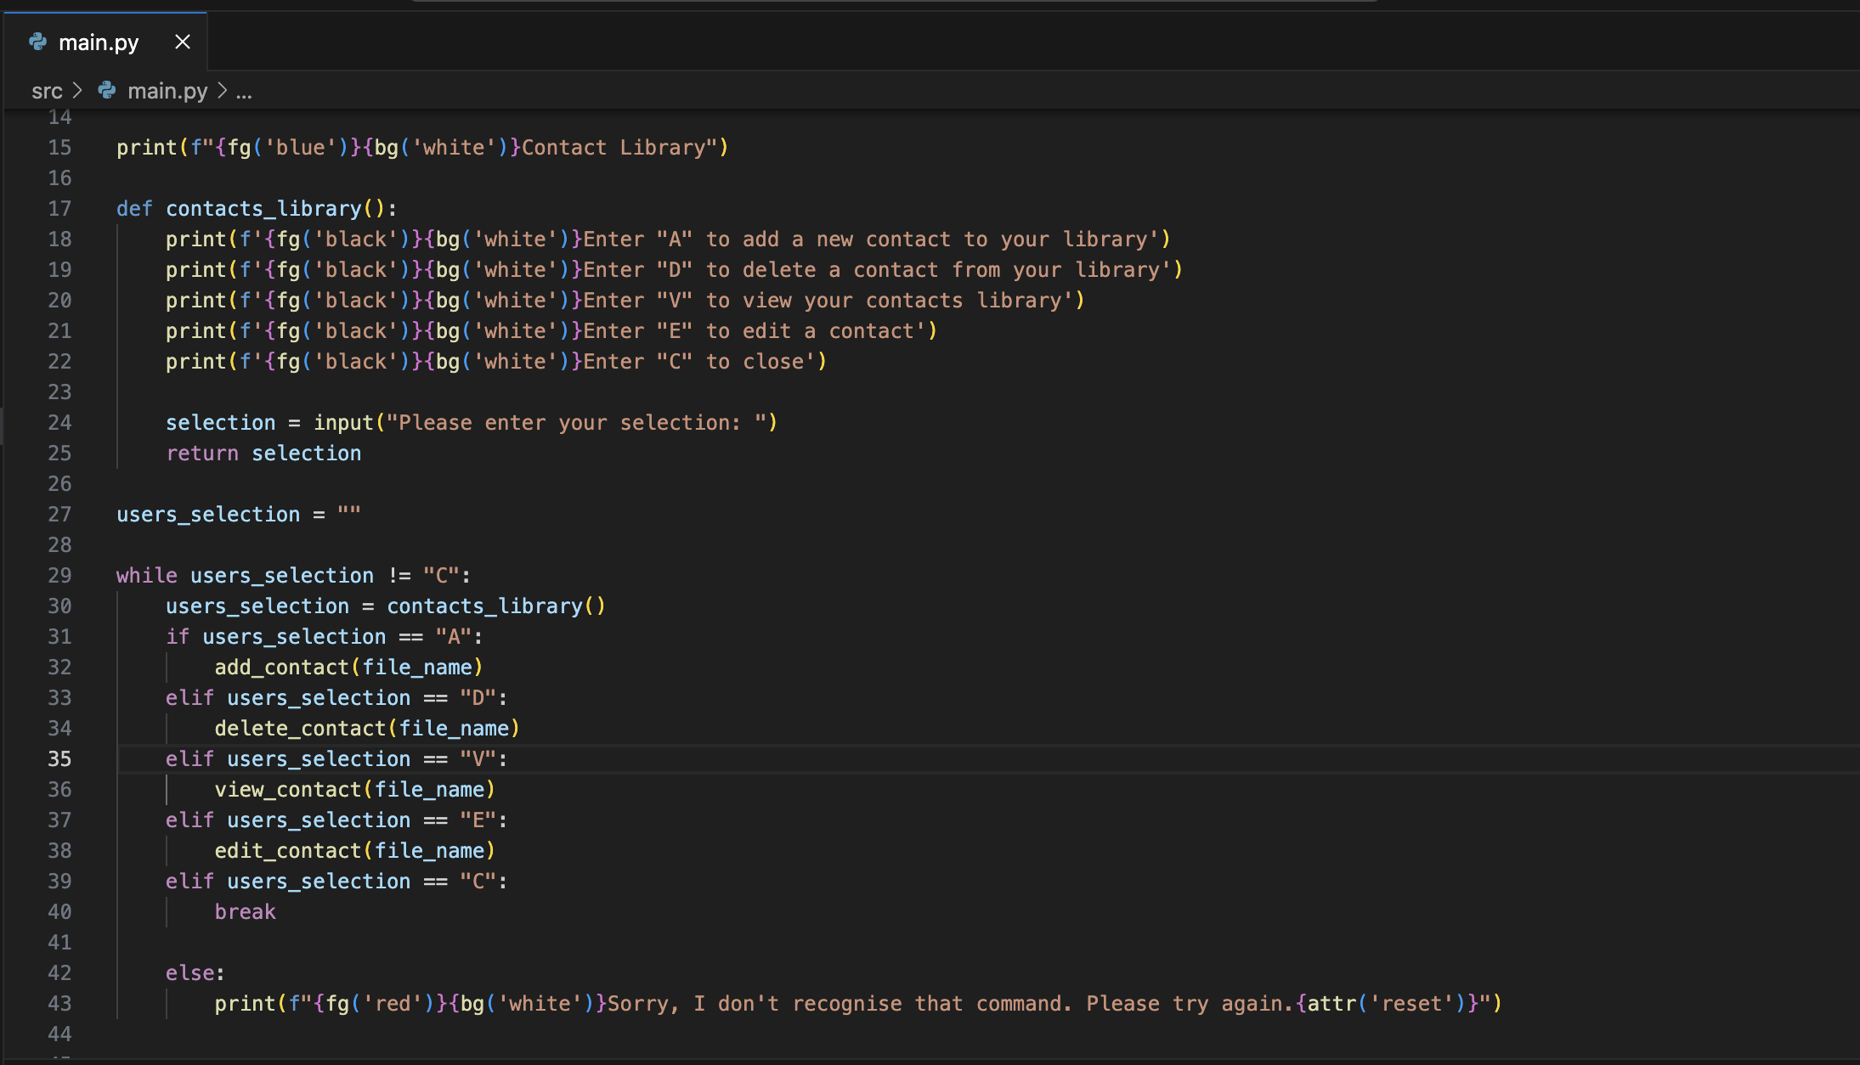
Contacts Library - Code

Slide 3



Contacts Library - Terminal

Slide 4

Try & Except Block

Slide 5
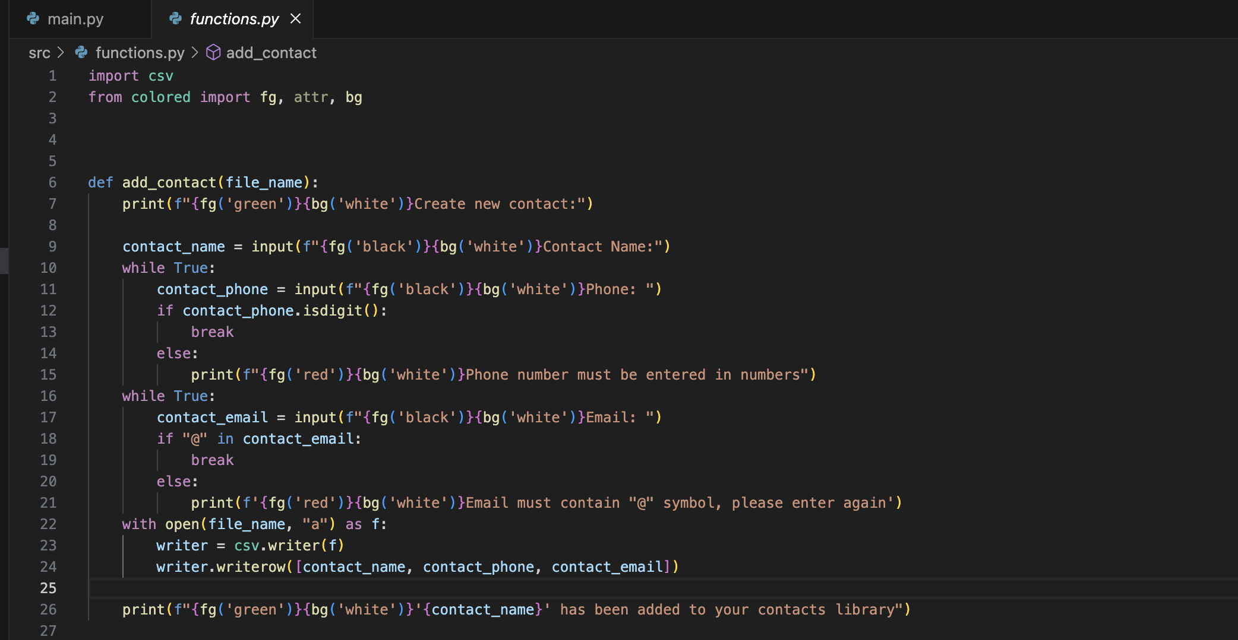
Add Contact - Code

Slide 6

Add Contact - Terminal

Slide 7
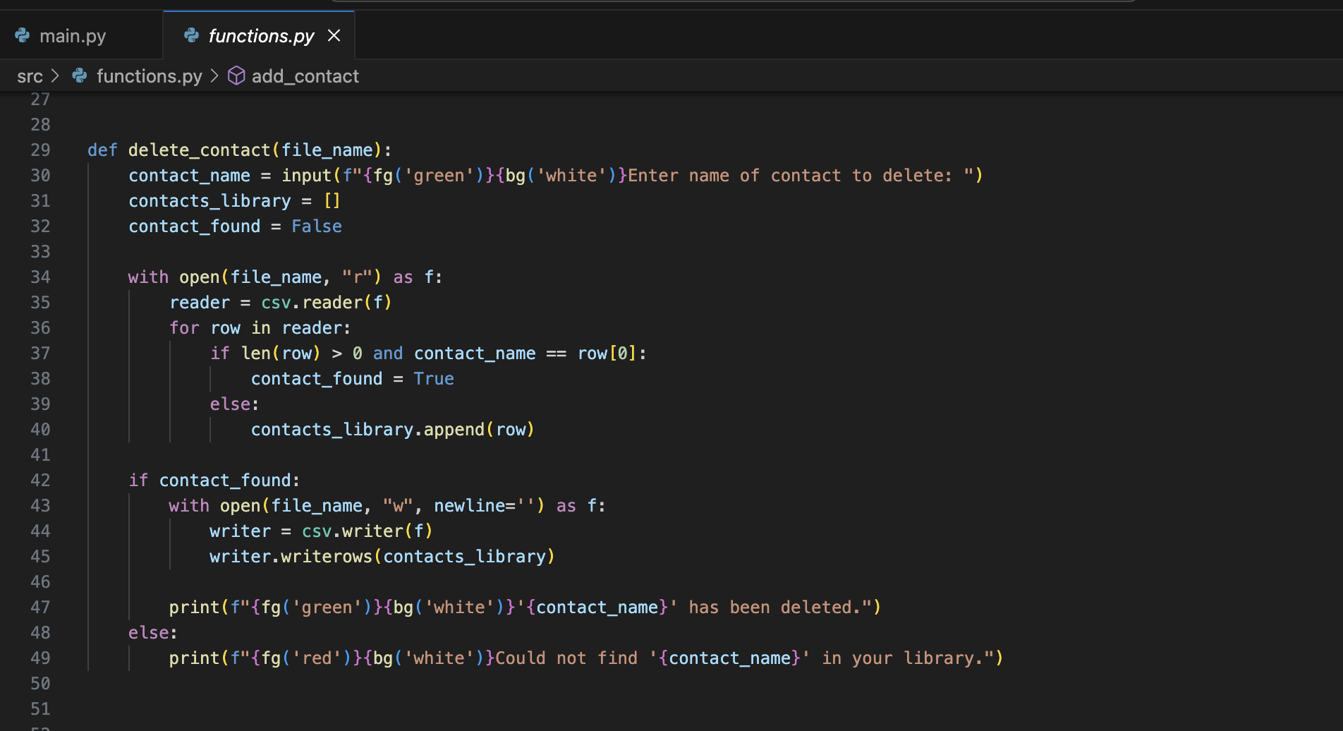
Delete Contact - Code

Slide 8


Delete Contact - Terminal

Slide 9

View Contacts - Code

Slide 10

View Contacts – Terminal

Slide 11
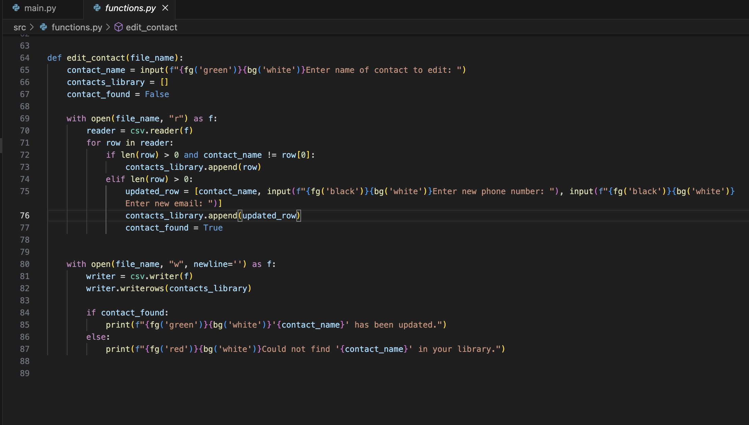
Edit Contact - Code

Slide 12


Edit Contact - Terminal

